Slide 1
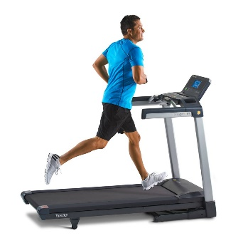
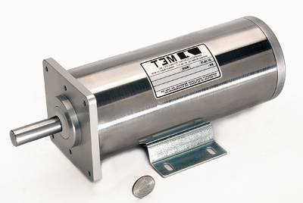
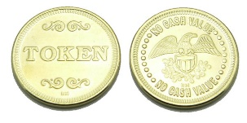
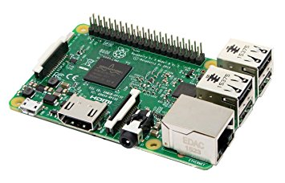
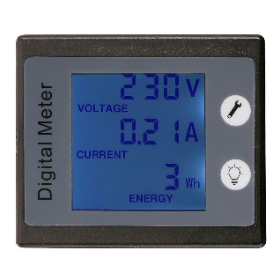
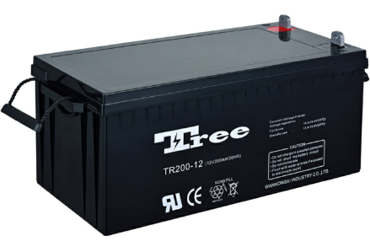
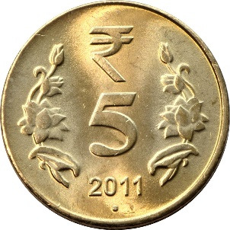
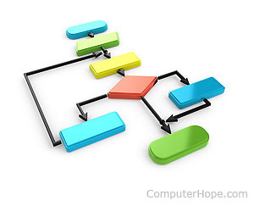
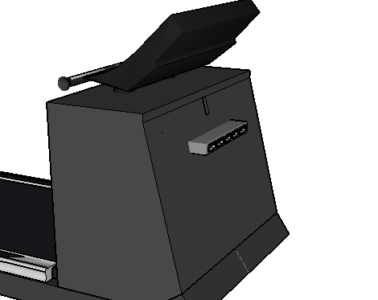
Power Generation
High Torque DC motor connected with running belt, which produces power.
Running Belt.
Machine will vend tokens
Control unit, which takes decision, when to vend tokens.
Battery for storing DC power generated by the motor.
Energy Meter to measure the power generated from DC motor.
Power Utilization
USB
port
Coin Insertion to get power on USB port, to charge electronic gadgets
Algorithm to verify coin or token
Power will be available on ports for limited time, to charge electronic gadgets.

